Slide 1

LightGBM Regressor

Slide 2


Definition
LightGBM Regressor is a gradient boosting framework that uses tree-based learning algorithms. It is designed for efficiency, speed, and high performance.

Slide 3
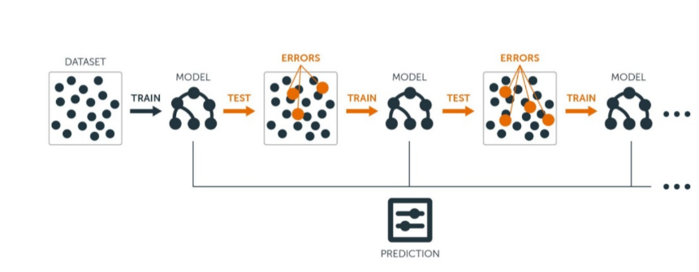
Image representation

Slide 4
Principle
LightGBM grows trees in a leaf-wise manner, leading to vertical growth.
Despite being more prone to overfitting, it's preferred for large datasets due to efficient loss reduction.
Leaf-wise growth effectively reduces loss using gradient-based methods.
While level-wise growth maintains a balanced tree, leaf-wise strategy optimally splits leaves for maximum loss reduction.
Leaf-wise growth can result in a balanced tree if required, but the vice-versa isn't possible.
Careful tuning of parameters like max_depth is crucial, as leaf-wise trees can be deeper while maintaining the same leaf count.

Slide 5

Advantages:
Speed and Efficiency: LightGBM is designed for high speed and efficiency, making it suitable for large datasets.
Optimized for Accuracy: Utilizes a novel technique called Gradient-based One-Side Sampling (GOSS) to reduce training time while maintaining accuracy.
Support for Large Datasets: Can handle large-scale datasets efficiently due to its distributed and memory-efficient algorithms.
Disadvantages:
Sensitivity to Hyperparameters: Performance can be sensitive to hyperparameters, requiring careful tuning.
Potential Overfitting: Like other gradient boosting algorithms, LightGBM can overfit if not properly tuned or regularized.
Complexity: Understanding and optimizing LightGBM models may require a deeper understanding of its parameters and workings.

Slide 6
import lightgbm as lgb
model = lgb.LGBMRegressor()
The LGBMRegressor class in the LightGBM library is used to create a LightGBM ensemble for regression tasks.

Slide 7
Applications:
Click-Through Rate Prediction: Predicting the likelihood of a user clicking on an online advertisement.
Predictive Maintenance: Forecasting when equipment or machinery is likely to fail based on sensor data.
Demand Forecasting: Predicting future demand for products or services.
Customer Segmentation: Identifying groups of customers with similar characteristics for targeted marketing.
LightGBM Regressor is a powerful algorithm known for its speed, efficiency, and accuracy in handling regression tasks. However, proper hyperparameter tuning and regularization are essential for achieving optimal results.

